Slide 1
Predicting the price of Bitcoin
Rojesh Dhakal

Slide 2


Disclaimer!!

Slide 3

Name: Rojesh Dhakal
Background: Data Science & Bitcoin Enthusiast
Motivation: Combining data science with enthusiasm for
Bitcoin to explore innovative ways to predict the price.
Expertise: Data analysis and modelling and machine learning techniques.
Goal: Data driven approaches to gain insights to make informed decisions.
Quote: "Data Science and Bitcoin are my two passions, and I believe in unlocking
secrets within data to provide valuable insights into the future of cryptocurrencies.”

Slide 4
CONTEXT
-Digital Currency
-21 million supply
-Digital Gold
-No Financial
Institutions

Slide 5
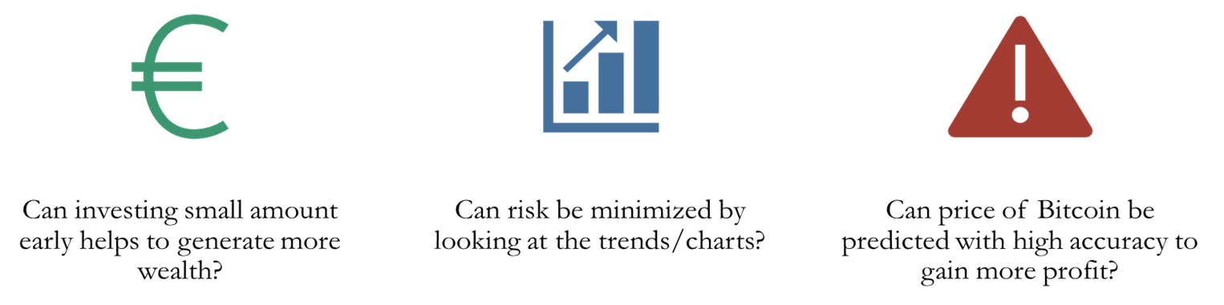
Business Question

Slide 6

Importance of Question

Slide 7

DATA PIPELINE

Slide 8





DATA OVERVIEW
YFINANCE
DATA FROM 2014-2023
7 FEATURES
3200 ROWS AND COLUMNS
CLEAN DATA

Slide 9
DATA PREPROCESSING
DATA FORMATTING
STANDARDIZATION

Slide 10
EXPLORATORY DATA ANALYSIS

Slide 11
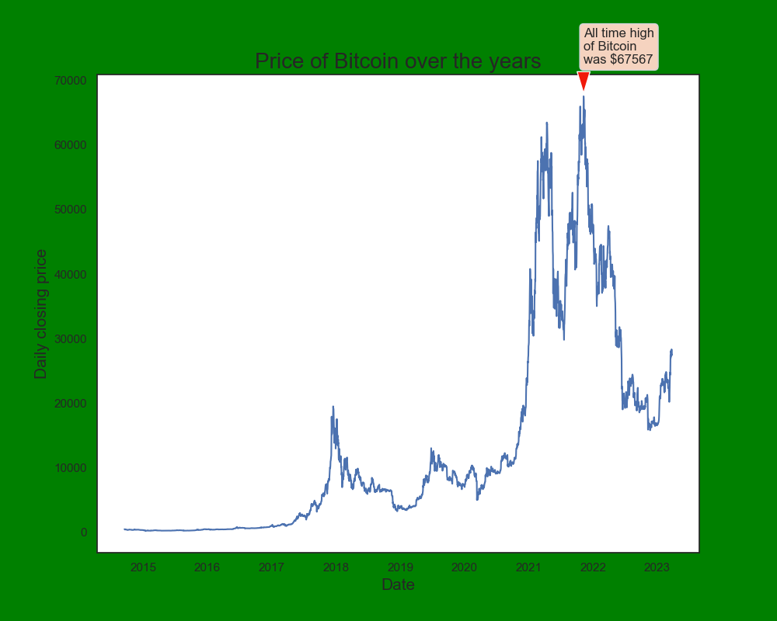
Closing Price over the years
Exponential Growth
All-time high of $67567

Slide 12
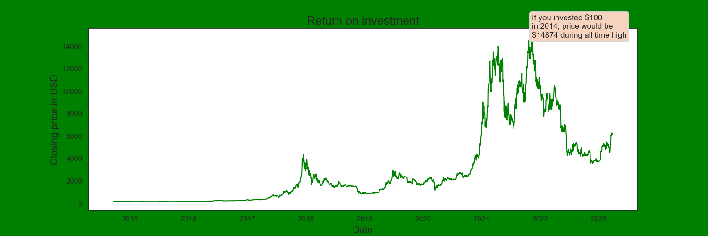
- $100 would be worth $14874 - 14774% whopping return
Return on Investment

Slide 13
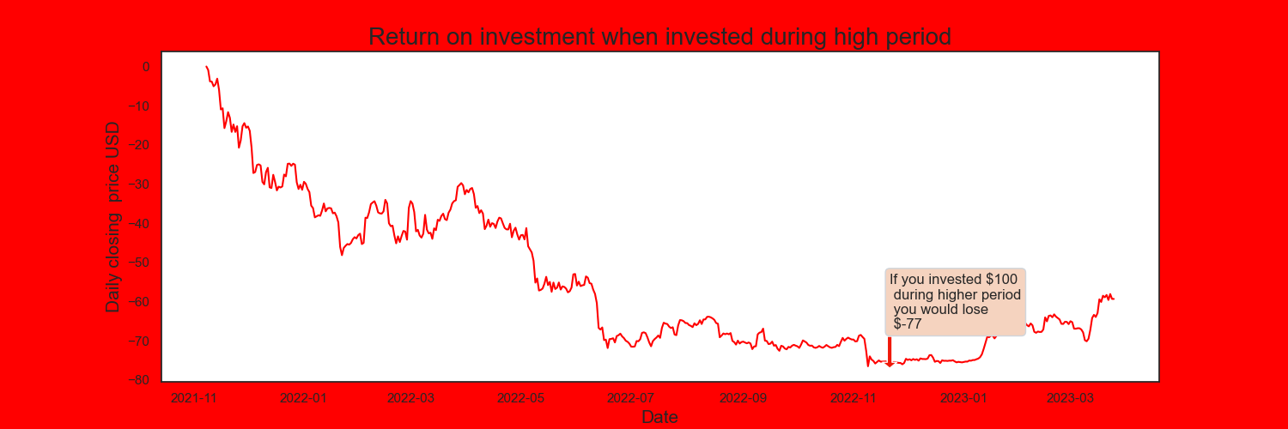
- $100 would be worth $23 - Loss of 177%
Return on Investment:

Slide 14
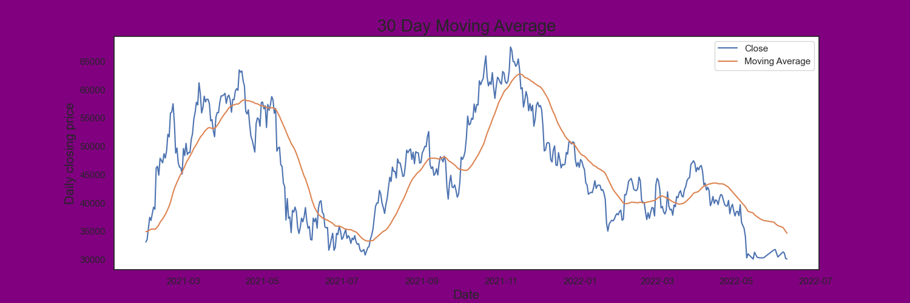
Moving Average
Buy/Sell Signal

Slide 15
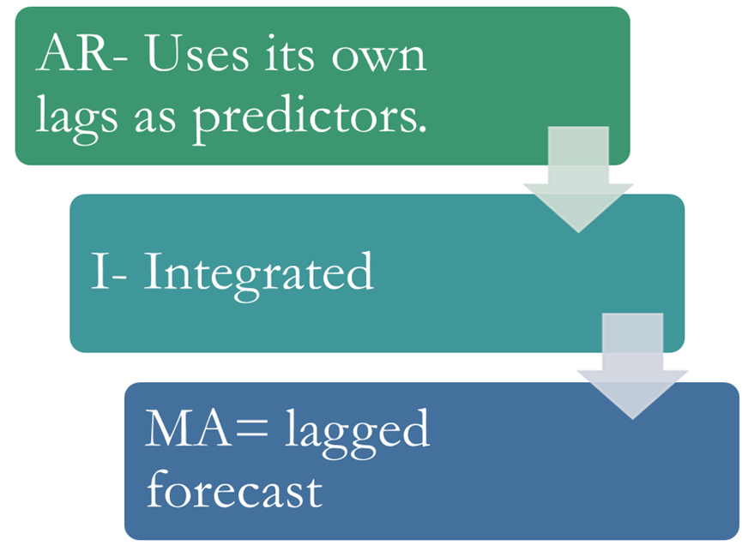
ARIMA Model

Slide 16
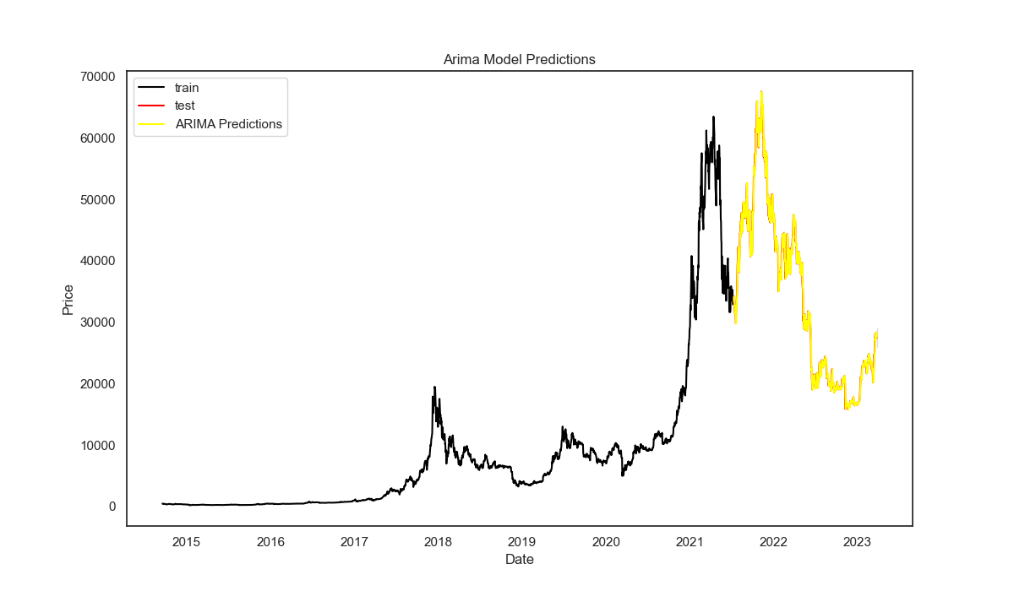
Predictions:
RMSE: 1214.39
MAPE: 2.34

Slide 17
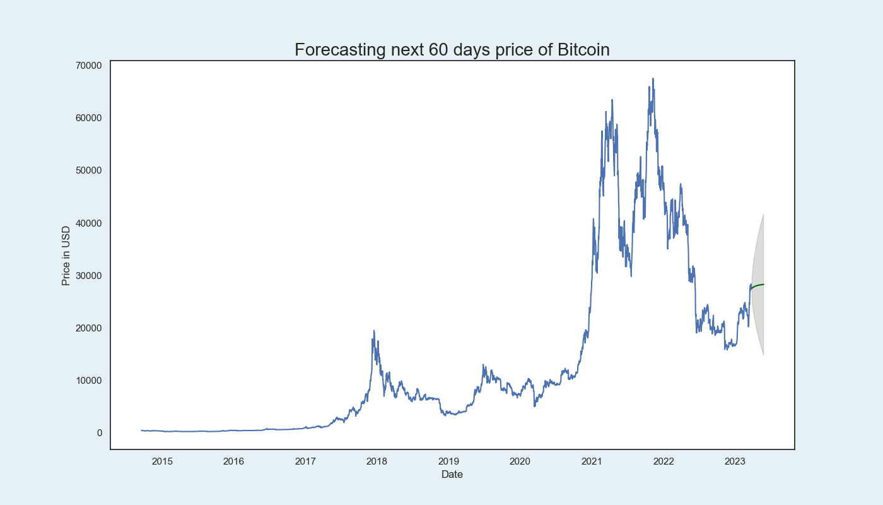
Forecasted
Higher= 41,00
Lower=14000

Slide 18
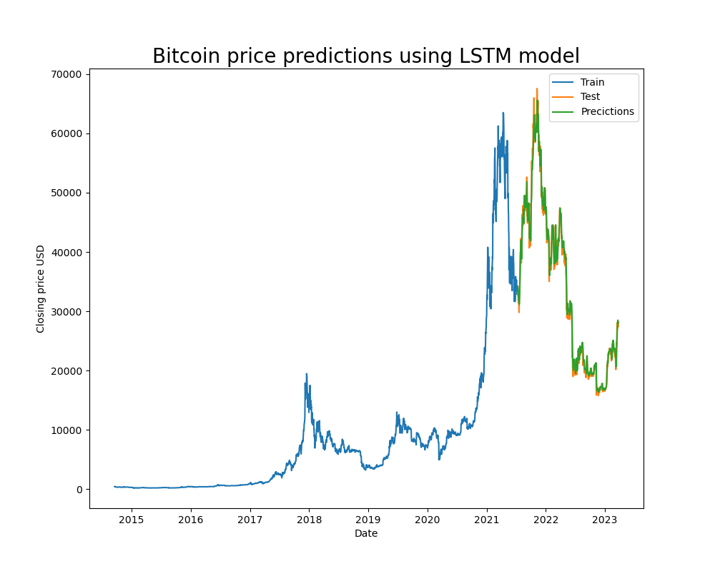
LSTM
LSTM
Type of recurrent neural network (RNN).
Composed of memory cells which can store long sequences of data.
Capture and propagate long-term dependencies in the input sequence.

Slide 19
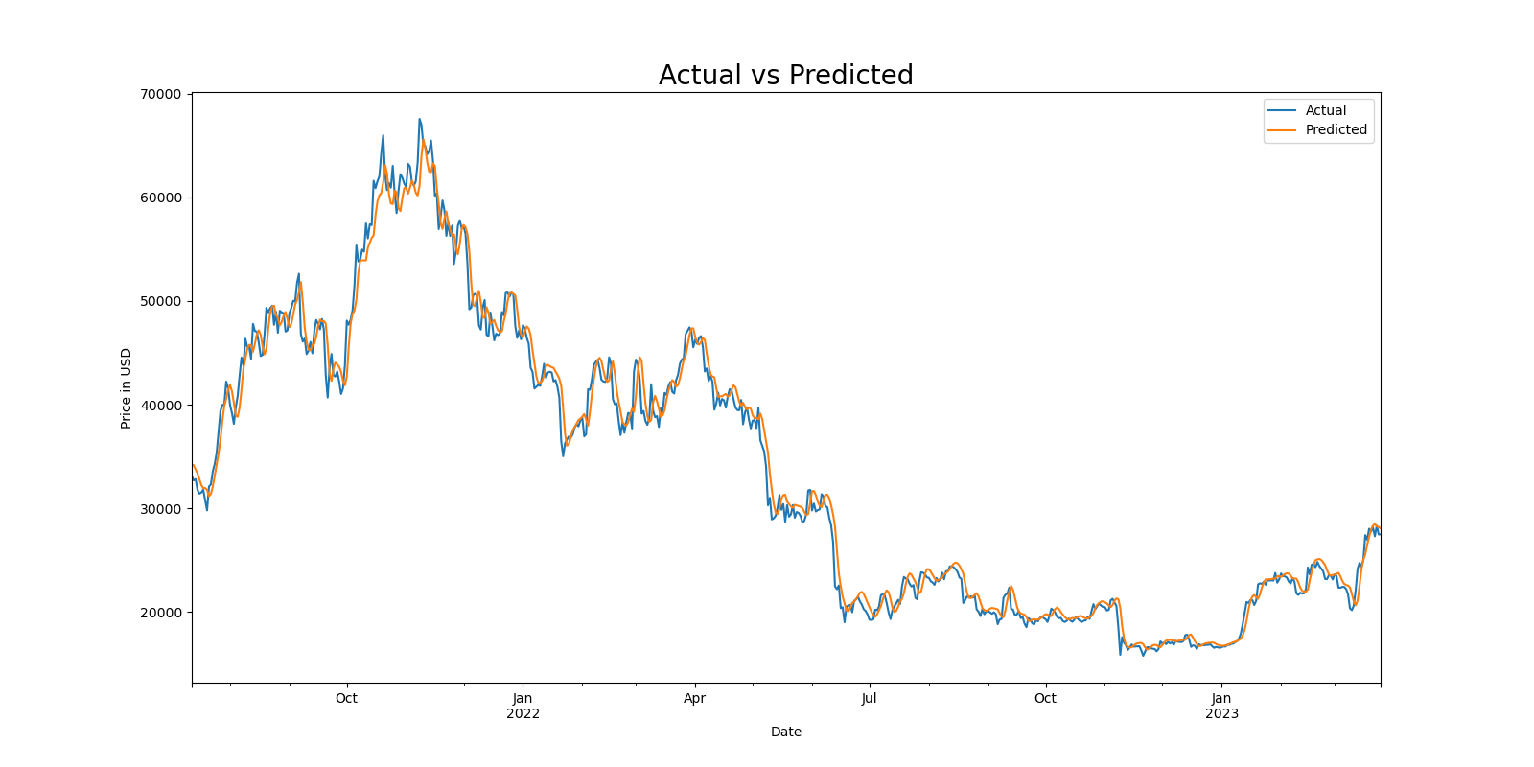
Actual Vs Prediction
RMSE: 437.93
MAPE: 3.52

Slide 20
Conclusion and Future Improvements
Conclusion
Future Improvements
LSTM seems to be performing well.
Prediction can be done with high accuracy.
Cannot fully implement it.
More features.
More historical data.
Ensemble techniques.

Slide 21


